Slide 1


Introduction to Machine Learning
Instituto de Matemática Aplicada San Luis
Universidad Nacional de San Luis
July 13, 2017

Slide 2
$ whoami
Juan Martín Loyola
BS. Computer Science
Doctoral Student
jmloyola@outlook.com

Slide 3
Disclaimer
I’m not an expert in Machine Learning.
I recently started learning Python

Slide 4
Before starting…
Install Python (preferably > 3.6.0)
Python https://www.python.org/downloads/
Anaconda https://www.continuum.io/downloads
Requirements:
Jupyter / iPython
Numpy
Matplotlib
Download CIFAR-10 dataset (~165MB)
Run the shell script /Notebook/complementary_code/datasets/get_datasets.sh
http://www.cs.toronto.edu/~kriz/cifar-10-python.tar.gz

Slide 5
Definition
A field of study that gives computers the ability to learn without being explicitly programmed.
A computer program is said to learn from experience E with respect to some class of tasks T and performance measure P, if its performance at tasks in T, as measured by P, improves with experience E.
Notes:
Professor Arthur Samuel, 1959
Tom Mitchell, 1997
Se dice que un programa de computadora aprende de la experiencia E con respecto a alguna clase de tareas T y medida de desempeño P, si su desempeño en tareas en T, medido por P, mejora con la experiencia E.
Aprendizaje = Mejorar con la experiencia en alguna tarea
Mejorar en la tarea T
con respecto a una medida de performance P
Basado en la experiencia E

Slide 6
Examples
A handwriting recognition learning problem:
Task T: recognizing and classifying handwritten words within images
Performance measure P: percent of words correctly classified
Training experience E: a database of handwritten words with given classifications
A robot driving learning problem:
Task T: driving on public four-lane highways using vision sensors
Performance measure P: average distance traveled before an error (as judged by human overseer)
Training experience E: a sequence of images and steering commands recorded while observing a human driver

Slide 7
History
Disciplines that influence Machine Learning:
Artificial Intelligence
Computational complexity theory
Information theory
Philosophy
Psychology and neurobiology
Bayesian methods
Statistics
Notes:
> Artificial intelligence
Learning symbolic representations of concepts. Machine learning as a search problem. Learning
as an approach to improving problem solving. Using prior knowledge together with training data
to guide learning.
> Bayesian methods
Bayes' theorem as the basis for calculating probabilities of hypotheses. The naive Bayes classifier.
Algorithms for estimating values of unobserved variables.
> Computational complexity theory
Theoretical bounds on the inherent complexity of different learning tasks, measured in terms of
the computational effort, number of training examples, number of mistakes, etc. required in order
to learn.
> Control theory
Procedures that learn to control processes in order to optimize predefined objectives and that learn to predict the next state of the process they are controlling.
> Information theory
Measures of entropy and information content. Minimum description length approaches to learning.
Optimal codes and their relationship to optimal training sequences for encoding a hypothesis.
> Philosophy
Occam's razor, suggesting that the simplest hypothesis is the best. Analysis of the justification for generalizing beyond observed data.
> Psychology and neurobiology
The power law of practice, which states that over a very broad range of learning problems,
people's response time improves with practice according to a power law. Neurobiological studies
motivating artificial neural network models of learning.
> Statistics
Characterization of errors (e.g., bias and variance) that occur when estimating the accuracy of a
hypothesis based on a limited sample of data. Confidence intervals, statistical tests.

Slide 8
History
1812: Bayes' Theorem
1913: Markov Chains
1950: Turing's Learning Machine
1951: First Neural Network Machine
1952: Machines Playing Checkers
1957: Perceptron
1967: Nearest Neighbor
1969: Limitations of Neural Networks
1970: Automatic Differentiation (Backpropagation)
1982: Recurrent Neural Network
1989: Reinforcement Learning
1995: Random Forest Algorithm
1995: Support Vector Machines
1997: IBM Deep Blue Beats Kasparov
2011: Beating Humans in Jeopardy
2016: Beating Humans in Go

Slide 9
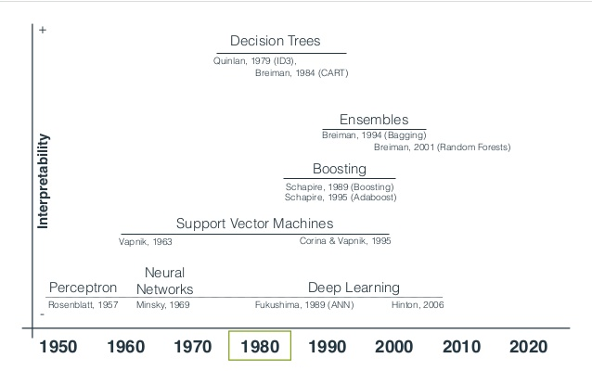
History

Slide 10

Problems Machine Learning tries to solve

Slide 11
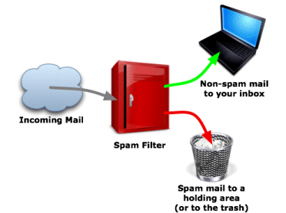
Supervised Learning
Task of inferring a function from labeled training data.
Each example is a pair consisting of an input object and a desired output value.
A supervised learning algorithm analyzes the training data and produces an inferred function, which can be used for mapping new examples.
Notes:
Supervised learning: The computer is presented with example inputs and their desired outputs, given by a "teacher", and the goal is to learn a general rule that maps inputs to outputs.

Slide 12
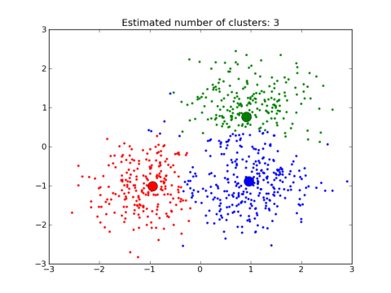
Unsupervised Learning
Task of inferring a function to describe hidden structure from "unlabeled" data.
Since the examples given to the learner are unlabeled, there is no evaluation of the accuracy of the structure that is output by the relevant algorithm
Notes:
Unsupervised learning: No labels are given to the learning algorithm, leaving it on its own to find structure in its input. Unsupervised learning can be a goal in itself (discovering hidden patterns in data) or a means towards an end (feature learning).

Slide 13
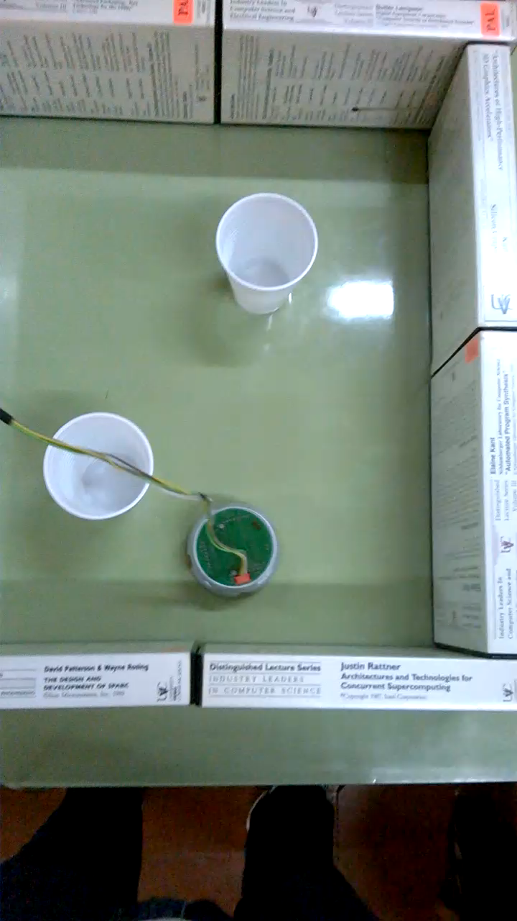

Reinforcement Learning
Concerned with how agents ought to take actions in an environment so as to maximize some notion of cumulative reward.
Notes:
Reinforcement learning: A computer program interacts with a dynamic environment in which it must perform a certain goal (such as driving a vehicle or playing a game against an opponent). The program is provided feedback in terms of rewards and punishments as it navigates its problem space.

Slide 14
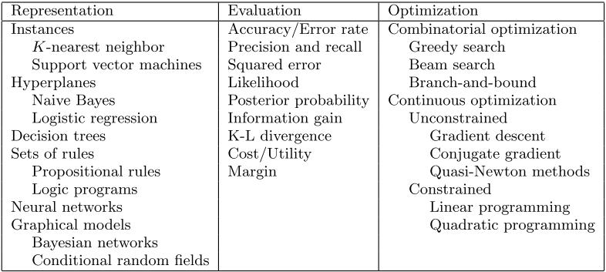
LEARNING = REPRESENTATION + EVALUATION + OPTIMIZATION
Notes:
Representation. A classifier must be represented in some formal language that the computer can handle. Conversely, choosing a representation for a learner is tantamount to choosing the set of classifiers that it can possibly learn. This set is called the hypothesis space of the learner. If a classifier is not in the hypothesis space, it cannot be learned. A related question, which we will address in a later section, is how to represent the input, i.e., what features to use.
Evaluation. An evaluation function (also called objective function or scoring function) is needed to distinguish good classifiers from bad ones. The evaluation function used internally by the algorithm may differ from the external one that we want the classifier to optimize, for ease of optimization (see below) and due to the issues discussed in the next section.
Optimization. Finally, we need a method to search among the classifiers in the language for the highest-scoring one. The choice of optimization technique is key to the efficiency of the learner, and also helps determine the classifier produced if the evaluation function has more than one optimum. It is common for new learners to start out using off-the-shelf optimizers, which are later replaced by custom-designed ones.

Slide 15
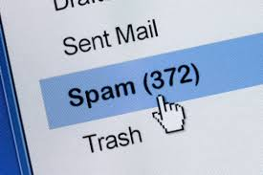
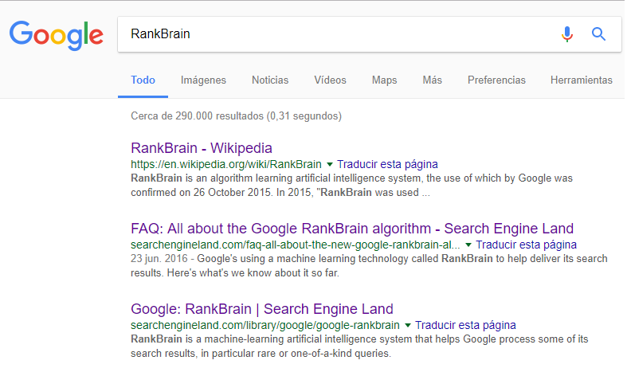
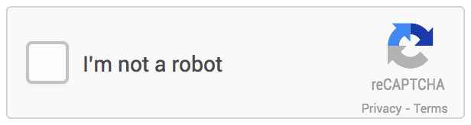
Applications

Slide 16
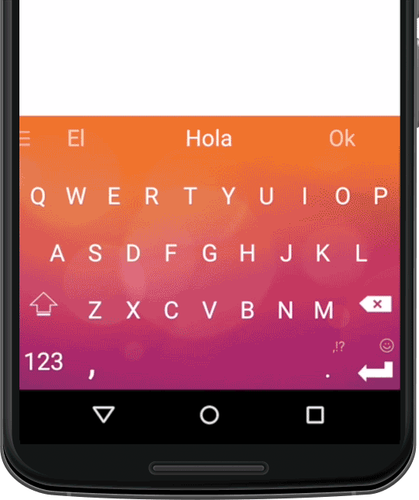
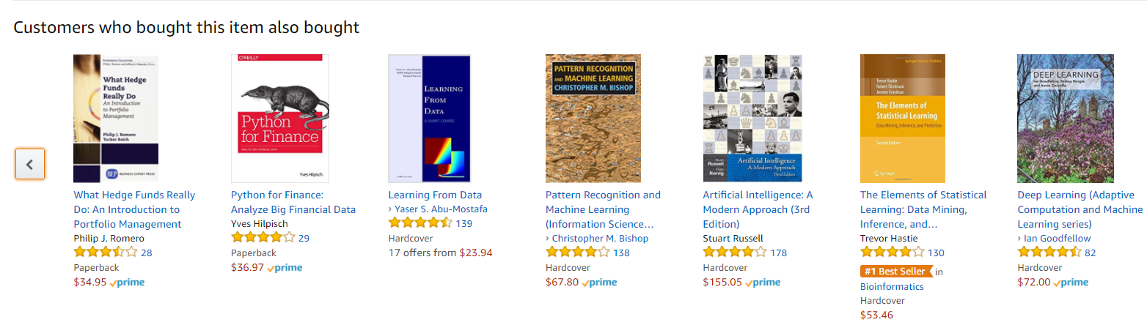
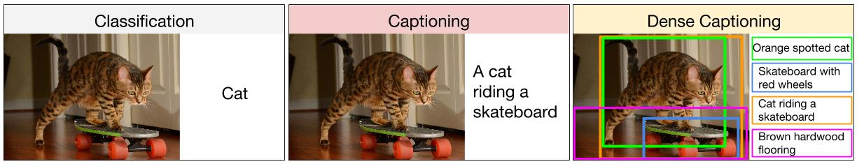
Applications

Slide 17
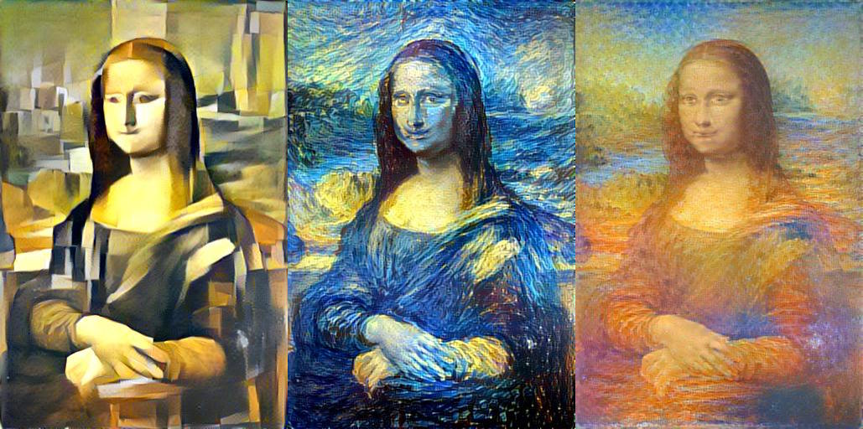
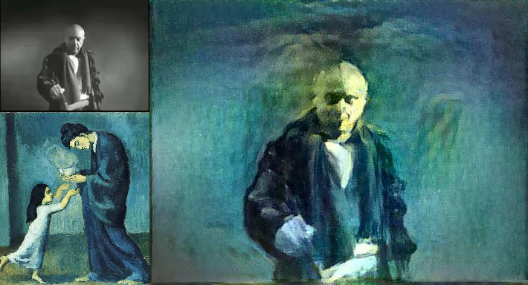
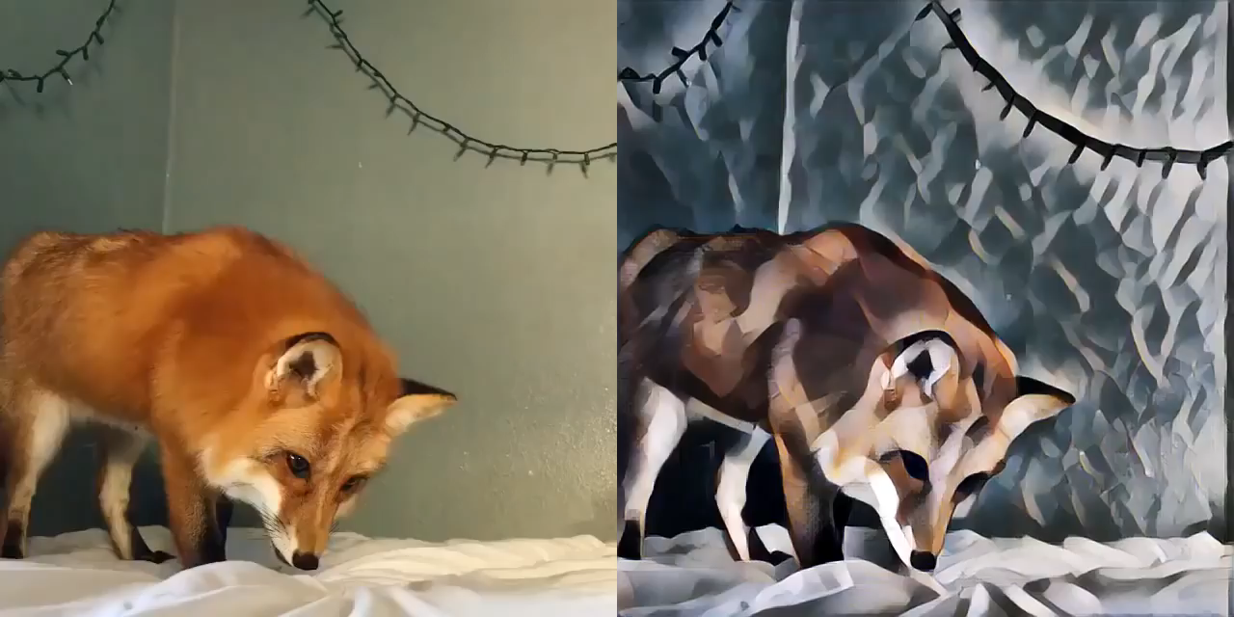
Applications

Slide 18
And many more…
Prediction of credit-worthy applicants.
Detection of credit card fraud.
Recognition of handwritten digit and letter at the post office.
Selecting relevant ads to show.
Finding “People You Might Know” in Facebook (friend suggestions).
Knowledge tracing and dropout detection for online courses.
Playing chess, go and jeopardy against top players.
Self-driving car.
Recommendation systems (Netflix, YouTube).

Slide 19

Image Classification Problem
The intent of the classification process is to categorize all pixels in a digital image into one of several classes.

Slide 20
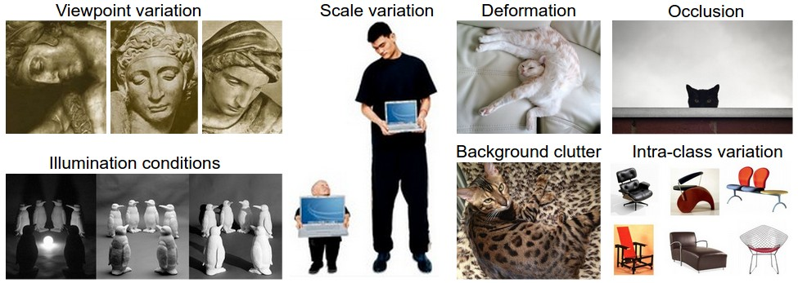
Image Classification Challenges

Slide 21
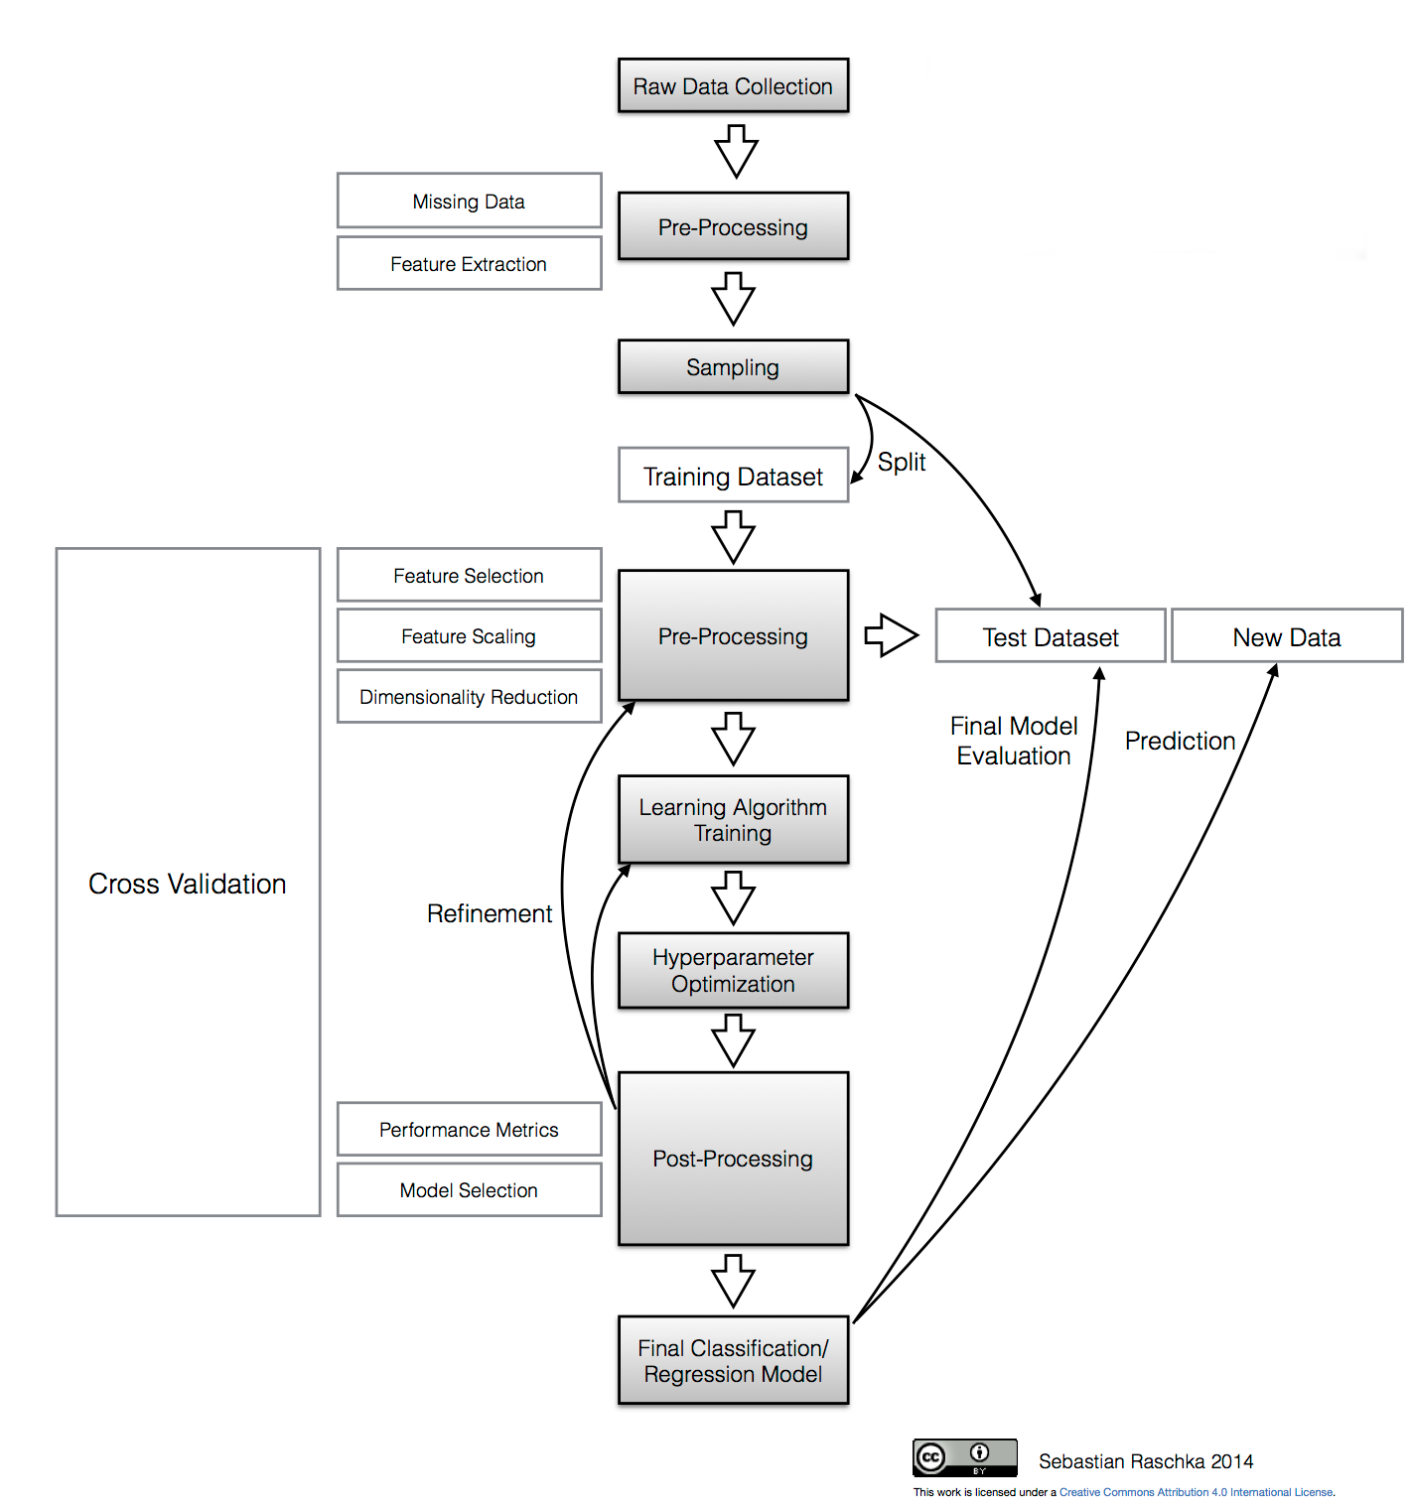
Supervised Learning Framework

Slide 22
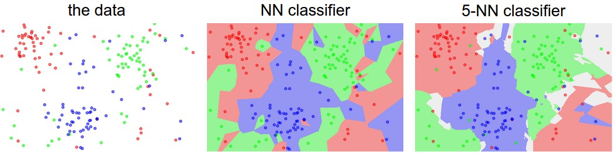
Nearest Neighbor Classifier

Slide 23
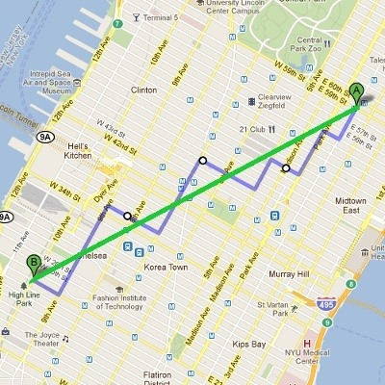


Distance Metrics
L1 (Manhattan) distance.
L2 (Euclidean) distance.
$$d_{1}\left(I_{1},I_{2}\right)=\sum_{p}{\left|I_{1}^{p}−I_{2}^{p}\right|}$$
$$d_{2}\left(I_{1},I_{2}\right)=\sqrt{\sum_{p}{{\left(I_{1}^{p}−I_{2}^{p}\right)}^{2}}}$$

Slide 24
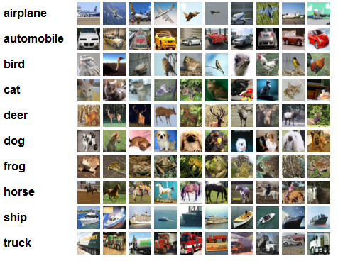
CIFAR-10 Dataset
10 labels
50000 training images
10000 test images

Slide 25
Supervised Learning Framework

Slide 26
Image Classification Assignment
https://github.com/PyDataSanLuis/Encuentros

Slide 27
Frameworks
Scikit-learn http://scikit-learn.org/stable/
WEKA http://www.cs.waikato.ac.nz/ml/weka/
TensorFlow https://www.tensorflow.org/
Theano http://deeplearning.net/software/theano/
PyMC3 http://pymc-devs.github.io/pymc3/
R packages:
nnet
randomForest
caret
kernlab
tree

Slide 28
Further Reading
“Machine Learning”. Online Course in Coursera from Andrew Ng. https://www.coursera.org/learn/machine-learning
“Convolutional Neural Networks for Visual Recognition”. Stanford’s Course from Fei-Fei Li. http://cs231n.github.io/
“Machine Learning”. Book from Tom Mitchell (1997).
“Pattern Recognition and Machine Learning”. Book from Michael Bishop (2006).
“The Elements of Statistical Learning: Data Mining, Inference, and Prediction”. Book from Trevor Hastie, Robert Tibshirani and Jerome Friedman (2009).

Slide 29

Questions?

